Slide 1
2025 Co-op program
A quick & updated guide to
getting some MARKETING $$ back
jENNIE WANG

Slide 2
Table of contents
What is Co-Op?
What Counts: Eligible Programs
What Doesn’t: Noneligible Programs
What do I have to do to get reimbur$$$ed?
Eligibility
Application Journey
Submit Application
Approval/Denial
Submit Tracking & Receipts
Confirmation and Get Paid
How is the program different in 2025 compared to 2024?
HELP I’m still confused?

Slide 3
WHAT IS CO-OP?

Slide 4
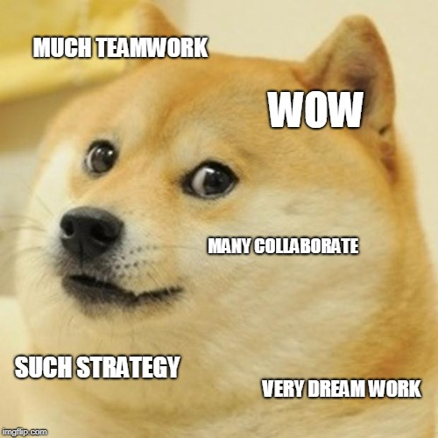
WHAT IS IT?
Objectives:
To encourage local marketing & branding
To foster collaboration among franchisees within the same local market
Long story short…we are dedicating $1.5M of the NAF to PAYING YOU BACK for a portion of your marketing spend.
You can get reimbursed for as much as 75% of your 2024 NAF contribution!!
Notes:
enhancing the collective impact and strengthening the Restore brand

Slide 5
WHAT counts
Local Marketing Collaboration | 45% of your program budget
Digital Media Campaign | 35% of your program budget
General Media Campaign | 35% of your program budget
Event Marketing | 35% of your program budget
Cause Marketing | 35% of your program budget
Agent Marketing | 35% of your program budget

Slide 6
LOCAL MARKETING COLLABORATION
Our strategic focus is to encourage franchisees to partner with one another within their local markets.
To qualify for this category:
Two or more franchises within the same market must be involved
To qualify for this category in digital marketing, franchises MUST work with Blueprint
To start a Collaborative Local PPC Campaign, reach out to Blueprint for a custom strategy that fits your local market.
Collaborative creative campaigns (billboard, radio, newspaper), events & sponsorship, etc.
Come up with your own ideas! We will approve on a case-by-case basis. Email marketingrequests@servicemaster.com
Collaborative Campaign Thought starters (Right click > Hyperlink > Open Hyperlink)

Slide 7
digital MARKETING
PPC, SEO, LSAs, social media, etc. through Blueprint (In-house Digital Team)
Preferred national vendors (such as Emma, Rallio, etc.)
Scorpion and third-party providers are no longer accepted (starting on Jul. 1, 2025).

Slide 8
GENERAL MEDIA
Billboards, print advertising, TV, radio, etc.
To promote brand consistency, all creative must be sent to marketingrequests@servicemaster.com for review and must be approved prior to use.
All assets published on the Marketing Hub are considered pre-approved.

Slide 9
EVENT MARKETING
National and Local Tradeshows & Sponsorships
We highly encourage any events associated with insurance companies SMR has national programs with:
Travelers
State Farm
AmFam
Farmers
Events for independent Insurance agents who work with the above insurance companies
Check with your RAM for national events in your area!

Slide 10
cause MARKETING
Franchisees are encouraged to get out into their community and participate in good causes that uplifts the community.
WE CARE: FIRE PREVENTION: partner with local fire departments to install smoke detectors in underprivileged communities
WE SERVE: VETERANS: raise funds to help make a meaningful impact on veterans and their families
Other local cause marketing events are approved on a case-by-case basis. Email marketingrequests@servicemaster.com for approval.
Notes:
This type of marketing improves relationships with local businesses and helps to further establish the Restore brand in your local market.

Slide 11
agent MARKETING
We encourage franchisees to build long lasting relationships with insurance agents.
One way to engage in agent marketing is through participating in the Preferred Partners Program.
To access the webinar, flighting schedule, and ready-to-use creative assets for this program, get on the Marketing Hub!

Slide 12
What doesn’t count
Excluded Items:
Membership dues
chambers, networking groups, golf courses, etc.
Printing costs
branded pens, totes, etc.
Yellow Pages
print or online listings
Personal events
such as parties held by a Franchisee for the sole purpose of supporting their organization
Salaries & benefits
Scorpion-related expenses (starting Jul. 1, 2025)
Digital media expenses from third-party providers

Slide 13
WHAT DO I HAVE TO DO TO GET $$$

Slide 14
ELIGIBILITY
Submission and Approval of the 3% Marketing Plan This is a separate program from Co-Op. You have to apply to Co-Op separately after your 3% marketing plan gets approved.
Use of the Scorpion Common Website Platform You cannot be using a third-party website.
Compliant to Brand Standards
You must be in good standing with all brand standards.
Notes:
Submission and Approval of the 3% Marketing Plan You must have submitted your 3% Marketing Plan for 2025 and received approval from the Marketing Team. Please note that the 3% Marketing Plan outlines your intended marketing spend for the year and is a prerequisite for Co-op participation. However, you must submit a separate Co-Op application to access funds. For more details on the local 3% spend requirement, click here.
Use of the Scorpion Common Website Platform Your franchise must be utilizing the Scorpion Common Website Platform to qualify. The utilization of 3rd party sites automatically disqualifies you for Co-Op participation.
Compliant to Brand Standards Franchisees must be in good standing with all brand standards in order to receive Co-Op funds. If your franchise falls out of good standing after Co-Op approval, you will not receive any reimbursement – unless the issues are resolved, and the business is returned to good standing within a grace period of 30 days.

Slide 15
APPLICATION JOURNEY
Submit Application
Approval
Submit BOTH Tracking & Receipts
Confirmation
Cha-Ching!
Denial

Slide 16
APPLICATION JOURNEY
Submit Application
Approval
Submit BOTH Tracking & Receipts
Confirmation
Cha-Ching!
Denial
10 business days
35 business days

Slide 17
APPLICATION JOURNEY: SUBMIT APPLICATION
Submit Application
Approval
Submit BOTH Tracking & Receipts
Confirmation
Cha-Ching!
Denial

Slide 18
APPLICATION JOURNEY: SUBMIT APPLICATION
Apply here: https://www.servicemasterrestore.com/co-op-application/
You can submit multiple applications until you meet your cap (75% of your 2024 NAF contribution).
Eg. If your 2024 NAF contribution was $10,000, the maximum Co-Op reimbursement you can receive in 2025 is $7,500.
Marketing initiatives that fall under different categories must be submitted through separate forms. But if multiple applications belong in the same category, COMBINE THEM!
Eg. you don’t need a separate application for PPC and LSA. You also don’t need a separate application for different locations.
You have to have spent at least $2,000 in one application to apply. If your application does not detail a program budget over $2,000, it will be denied.
Applications open till November 1st, 2025, or when funds are earmarked; whichever comes first. APPLY EARLY!!!

Slide 19
APPLICATION JOURNEY: SUBMIT APPLICATION
Local Marketing Collaboration application:
The group will nominate a lead franchise. The lead franchise will be responsible for submitting the application and gathering and submitting tracking documentation and receipts.
Must fill out the Local Marketing Collaboration Qualification Form (find it on the bottom of the application site).

Slide 20
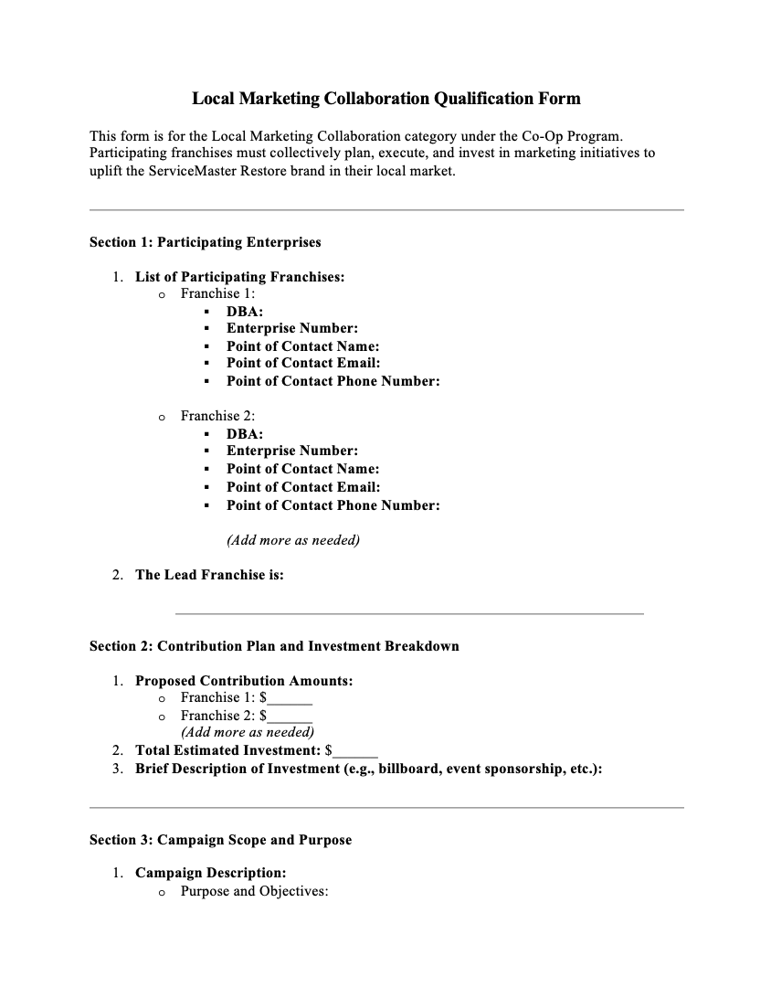
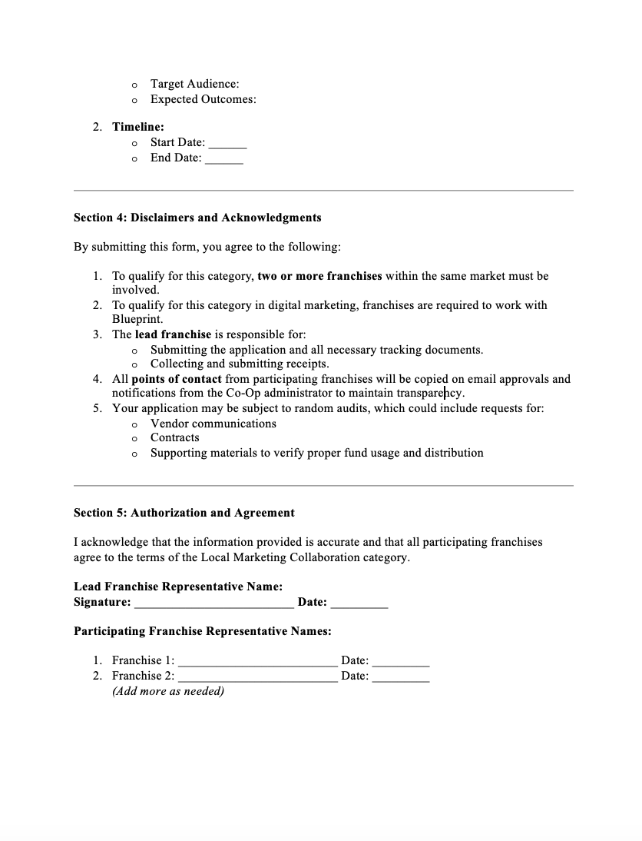
APPLICATION JOURNEY: SUBMIT APPLICATION
All participating franchises must pre-agree on the distribution of funds and submit a signed qualification form.

Slide 21
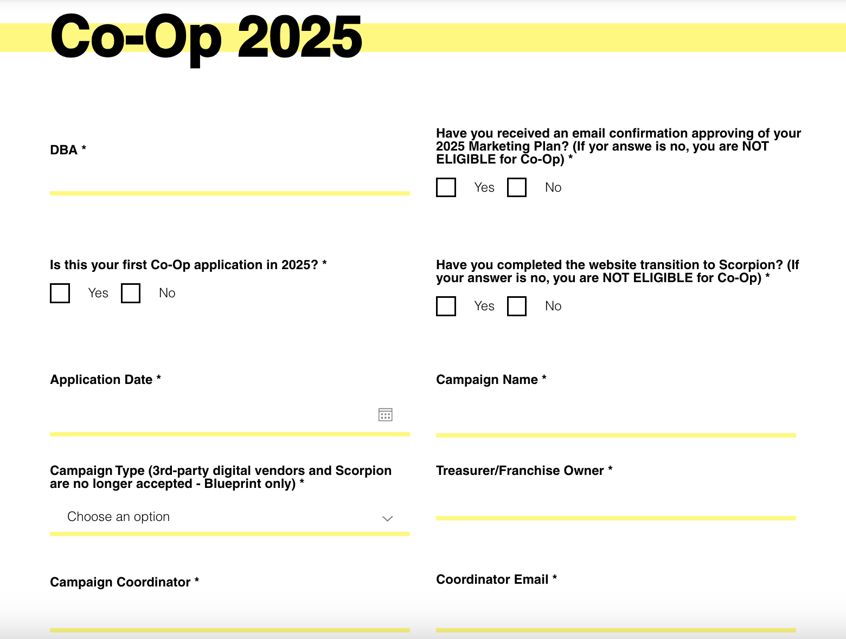
APPLICATION JOURNEY: SUBMIT APPLICATION
If you have multiple applications, the campaign name should help you tell them apart
Who should I follow up with questions?

Slide 22
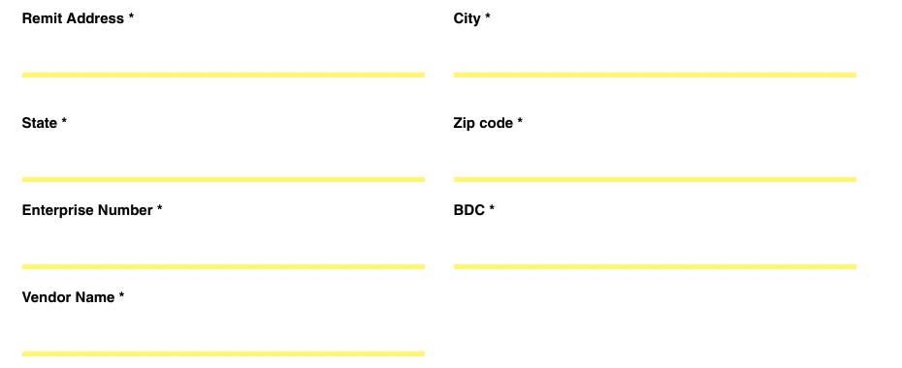
APPLICATION JOURNEY: SUBMIT APPLICATION
Who provided this marketing service? Tradeshow name/Lamar/etc.

Slide 23
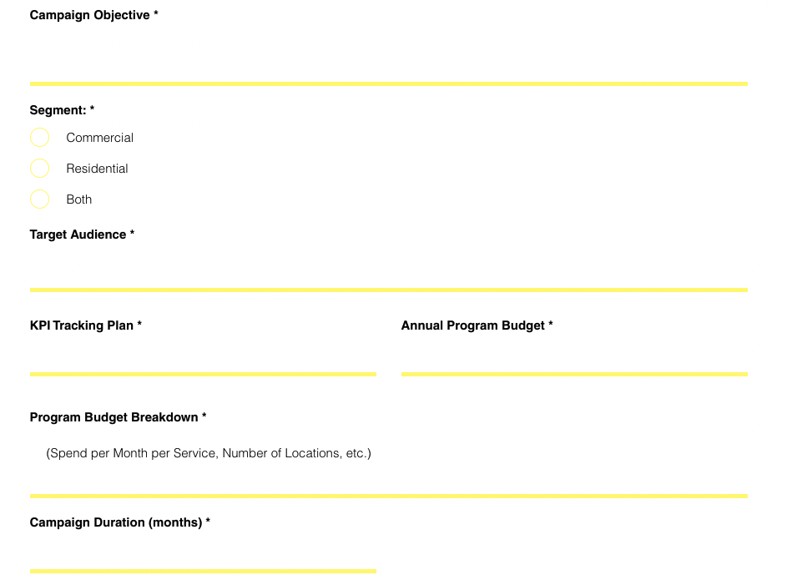
APPLICATION JOURNEY: SUBMIT APPLICATION
Why are you investing in this program? And how does it support SMR as a brand?
Who are you doing this for?
Insurance agents? Home-owners? Other?
Listenership? Leads? Click-through rate?
How much are you spending on the program within the year? Must be >$2k
Explain in detail how the budget is being spent

Slide 24
APPLICATION JOURNEY: SUBMIT APPLICATION
The submit button only appears after all 5 boxes are checked

Slide 25
APPLICATION JOURNEY: SUBMIT APPLICATION
When you see this screen, you just completed your first step! YAY

Slide 26
APPLICATION JOURNEY: APPROVAL
Submit Application
Approval
Submit BOTH Tracking & Receipts
Confirmation
Cha-Ching!
Denial

Slide 27
APPLICATION JOURNEY: APPROVAL
Within 10 business days of submission, you will receive a confirmation email with a confirmation number and a copy of your submission.
REMEMBER YOUR CONFIRMATION NUMBER! You’ll need it later.
All Co-Op applications must be submitted and approved before the start of the campaign with the exception of CAT events. These will be considered on a case-by-case basis.
Local Marketing Collaboration category: All points of contact from each participating franchises will be copied on email approvals and notifications from the Co-Op administrator to maintain transparency.

Slide 28
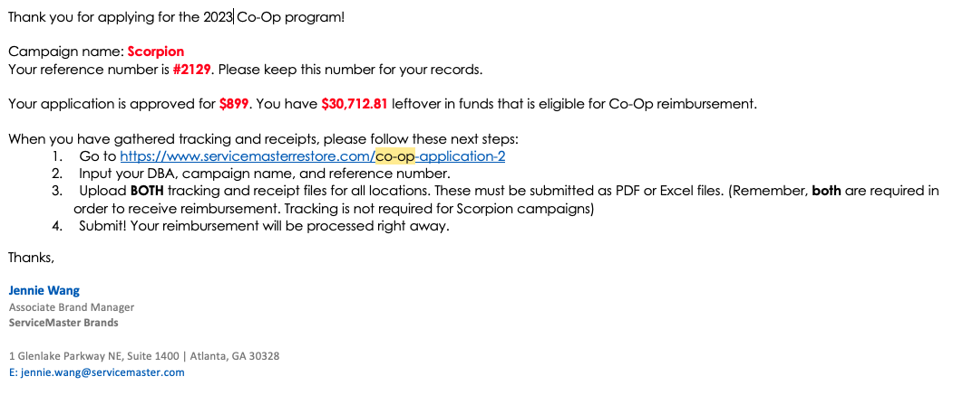
APPLICATION JOURNEY: APPROVAL
SAMPLE APPROVAL EMAIL
How much you have left until hitting your reimbursement cap (75% of 2024 NAF)
How much is earmarked for you (35% or 45% of your program budget)

Slide 29
APPLICATION JOURNEY: APPROVAL
If you reach out to me with questions about your application, mention your confirmation number
The reimbursement will not exceed the approved amount but could be less depending on the receipted received
The amount of leftover funds tells you how much Co-Op funds you can still claim by submitting more applications

Slide 30
APPLICATION JOURNEY: DENIAL
Submit Application
Approval
Submit BOTH Tracking & Receipts
Confirmation
Cha-Ching!
Denial

Slide 31
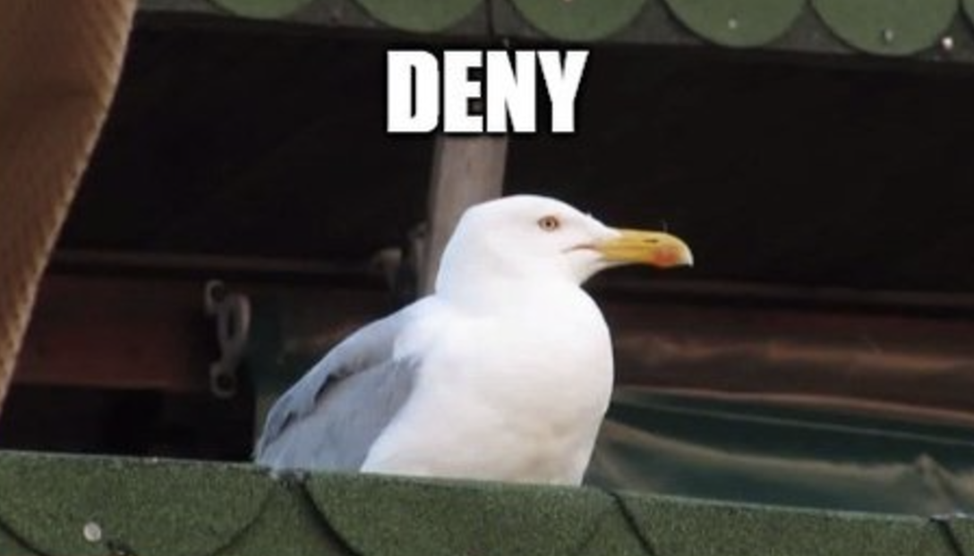
APPLICATION JOURNEY: DENIAL
If your application is denied, you will receive an email within 10 business days with reasons for denial.

Slide 32
APPLICATION JOURNEY: Submit tracking & receipts
Submit Application
Approval
Submit BOTH Tracking & Receipts
Confirmation
Cha-Ching!
Denial

Slide 33
APPLICATION JOURNEY: SUBMIT TRACKING & RECEIPTS
Submit tracking & receipts here: https://www.servicemasterrestore.com/co-op-application-2
Don’t submit tracking & receipts before you are approved – It only prolongs your wait time
Receipts for year-round programs can be submitted on a monthly, quarterly, or annual basis.
If you have multiple receipts/invoices, please merge all files into 1 PFD and submit one application. DO NOT fill out a separate submission for each receipt – you will be asked to resubmit.
All receipt submissions must meet a minimum threshold of $1,000. Submissions below this amount will be returned for consolidation.

Slide 34
APPLICATION JOURNEY: SUBMIT TRACKING & RECEIPTS
Submissions containing more than three receipts or invoices must include a cover page with an itemized breakdown of the expenses.
For Local Marketing Collaboration, the leading franchise is required to submit an itemized breakdown of contributions from each participating franchise AND a summary of how the reimbursement will be divided.
Must be submitted by December 9th, 2025, or YOU WILL NOT BE REIMBURSED.

Slide 35
APPLICATION JOURNEY: SUBMIT TRACKING & RECEIPTS
Local Marketing Collaboration | Local Marketing Collaboration Qualification form (required at the application phase) Required documentation based on the category of the campaign (see below)
Digital Media Campaign | Blueprint ONLY: Receipts/Invoices (no tracking necessary)
General Media Campaign | 1. Receipts/invoices 2. KPI reporting provided by vendor
Event Marketing | Receipts/invoices Tradeshow & Sponsorship leads form Events Qualification form OR tracked in Luxor
Cause Marketing | 1. Receipts/invoices 2. Cause Marketing tracking form
Agent Marketing | Receipts/invoices Luxor OR Agent Marketing Tracking Form
You can find all the forms on the bottom of the Co-Op application site

Slide 36
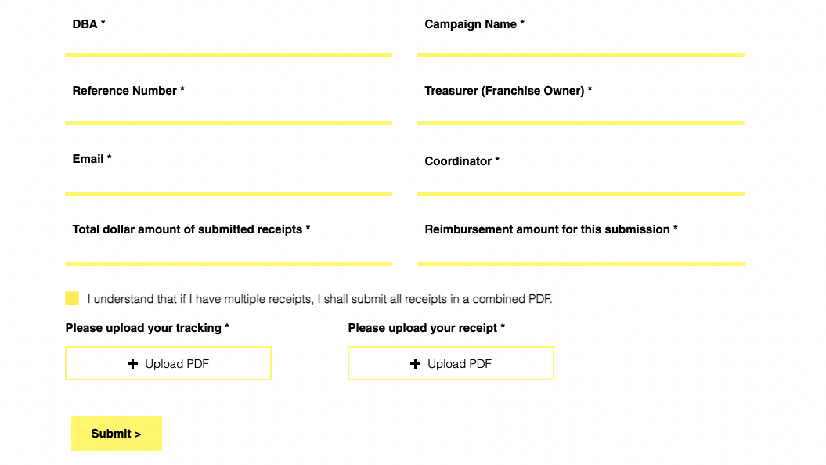
APPLICATION JOURNEY: SUBMIT TRACKING & RECEIPTS
How much do the attached receipts add up to?
How much are you expecting in reimbursement? (35% or 45% of the number on the left)

Slide 37
APPLICATION JOURNEY: CONFIRMATION
Submit Application
Approval
Submit BOTH Tracking & Receipts
Confirmation
Cha-Ching!
Denial

Slide 38
APPLICATION JOURNEY: confirmation
SAMPLE CONFIRMATION

Slide 39
APPLICATION JOURNEY: GETTING PAID
Submit Application
Approval
Submit BOTH Tracking & Receipts
Confirmation
Cha-Ching!
Denial

Slide 40
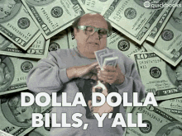
APPLICATION JOURNEY: GETTING PAID
(It will be an ACH payment)

Slide 41
HOW IS 2025 DIFFERENT?

Slide 42
2024 VS. 2025 IN CO-OP
New! Local Marketing Collaboration category
New! Digital Media category updates
Blueprint ONLY
You have to submit receipts (no tracking needed)
New! Receipt submission updates
$1000 minimum threshold
Cover page required for 3 or more receipts

Slide 43
HELP I’M STILL CONFUSED?

Slide 44
RESOURCES
2025 Co-Op Guidelines
This presentation
Marketing Newsletter (deadline reminders, Co-Op closing/extension, everything important)
Me ☺
Jennie.wang@servicemaster.com
Notes:
Marketingrequests@servicemaster.com
ZenDesk

Slide 45
APPLY EARLY
REMEMBER YOUR DEADLINES

Slide 46
Milestone | Deadline
Application Opens | January 31, 2025
Application Closes | November 1, 2025, or when funds are 100% earmarked, whichever comes first
Receipts Submission | December 9, 2025

Slide 47
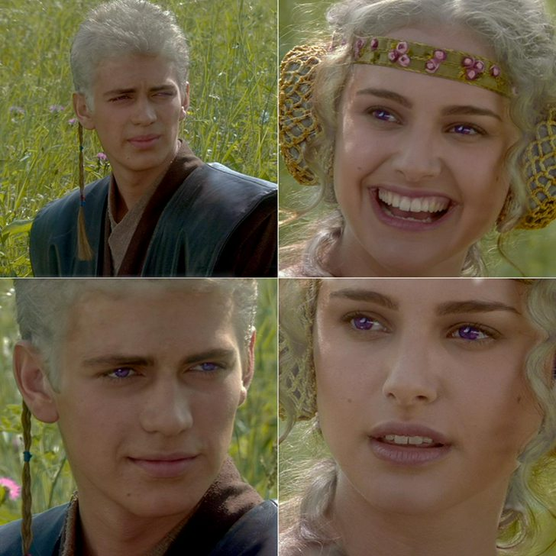
I’ll apply for Co-Op
ASAP, right?
ASAP, right?

Slide 48
QUESTIONS?

